Slide 1
Recurrent Neural network
Time Series or Sequence Analysis

Slide 2
RNN
Recurrent Neural Network(RNN) are a type of Neural Network where the output from previous step are fed as input to the current step.
RNN have a “memory” which remembers all information about what has been calculated.
RNN are effective for sequence data like
Time-Stamped Sales Data,
Sequence of text in a sentence,
Biological Sequence Data for example Heart Beat Data etc.

Slide 3
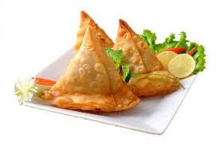
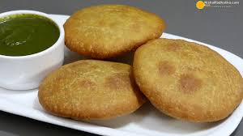
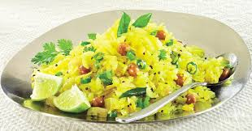
Cooking Schedule
MONDAY TUESDAY WEDNESDAY THURSDAT FRIDAY SATURDAY

Slide 4
Recurrent Neural Network
RNN

Slide 5
Recurrent Neural Network
RNN

Slide 6
Recurrent Neural Network
RNN

Slide 7
Recurrent Neural Network
RNN

Slide 8
Recurrent Neural Network
RNN

Slide 9
Recurrent Neural Network
RNN

Slide 10
Recurrent Neural Network
RNN

Slide 11
Applications
Stock Prediction
Next Day Stock Price
Sequence Prediction
2 4 6 8 ….?
Text Generation
How are You ……?
Voice Recognition
Next word you are going to speak
Order is Important Here
Learn from History [1 2 3 4]→ [2 3 4 5]

Slide 12
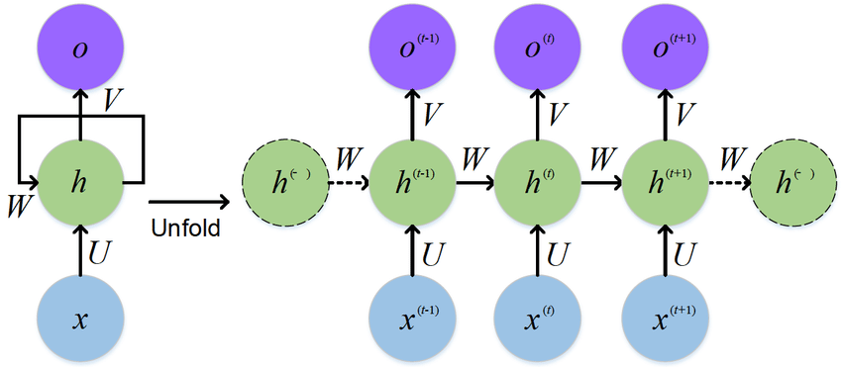
RNN Architecture
Sequence to Sequence ( Many to Many)
Given 5 Words, Predict Next Five as Answer (Chat Bot)

Slide 13
RNN Architecture
Sequence to Vector ( Many to One)
Given 5 Words, Predict Next Word

Slide 14
RNN Architecture
Vector to Sequence ( One to Many)
Given 1 Words, Predict Next 5

Slide 15
RNN
Cells that are a function of input from previous time steps are also known as memory cells.
RNN are also flexible in their inputs and outputs, for both sequences and single vector values.

Slide 16

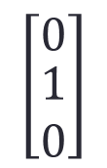

Vectors
$$\left[\begin{matrix}1 \\ \begin{aligned}0 \\ 0\end{aligned}\end{matrix}\right]$$
$$\left[\begin{matrix}0 \\ \begin{aligned}1 \\ 0\end{aligned}\end{matrix}\right]$$
$$\left[\begin{matrix}0 \\ \begin{aligned}0 \\ 1\end{aligned}\end{matrix}\right]$$

Slide 17
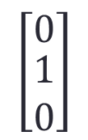

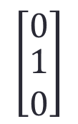
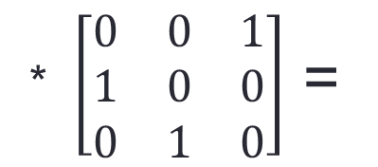



Input, Weight and Output Vectors
$$\left[\begin{matrix}1 \\ \begin{aligned}0 \\ 0\end{aligned}\end{matrix}\right]$$
$$\left[\begin{matrix}0 \\ \begin{aligned}1 \\ 0\end{aligned}\end{matrix}\right]$$
* $\left[\begin{matrix}0 & 0 & 1 \\ 1 & 0 & 0 \\ 0 & 1 & 0\end{matrix}\right]$ =
$$\left[\begin{matrix}0 \\ \begin{aligned}1 \\ 0\end{aligned}\end{matrix}\right]$$
$$\left[\begin{matrix}0 \\ \begin{aligned}0 \\ 1\end{aligned}\end{matrix}\right]$$
$$\left[\begin{matrix}0 \\ \begin{aligned}0 \\ 1\end{aligned}\end{matrix}\right]$$
$$\left[\begin{matrix}1 \\ \begin{aligned}0 \\ 0\end{aligned}\end{matrix}\right]$$

Slide 18

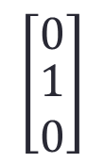
Simple RNN
1
0
$$\left[\begin{matrix}1 \\ \begin{aligned}0 \\ 0\end{aligned}\end{matrix}\right]$$
$$\left[\begin{matrix}0 \\ \begin{aligned}1 \\ 0\end{aligned}\end{matrix}\right]$$
0
1
0
0

Slide 19
Simple RNN
1
0
0
1
0
0

Slide 20

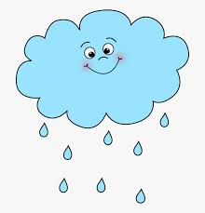
Cooking Schedule
MONDAY TUESDAY WEDNESDAY THURSDAT FRIDAY SATURDAY

Slide 21
Recurrent Neural Network
RNN

Slide 22


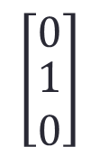


Vectors
$$\left[\begin{matrix}1 \\ \begin{aligned}0 \\ 0\end{aligned}\end{matrix}\right]$$
$$\left[\begin{matrix}0 \\ \begin{aligned}1 \\ 0\end{aligned}\end{matrix}\right]$$
$$\left[\begin{matrix}0 \\ \begin{aligned}0 \\ 1\end{aligned}\end{matrix}\right]$$
$$\left[\begin{aligned}1 \\ 0\end{aligned}\right]$$
$$\left[\begin{aligned}0 \\ 1\end{aligned}\right]$$

Slide 23
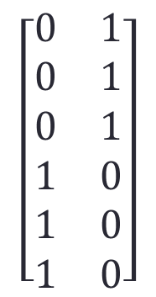
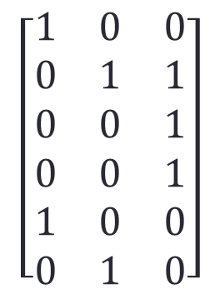
More Complicated RNN
$$\left[\begin{matrix}1 & 0 & 0 \\ 0 & 1 & 1 \\ 0 & 0 & 1 \\ 0 & 0 & 1 \\ 1 & 0 & 0 \\ 0 & 1 & 0\end{matrix}\right]$$
$$\left[\begin{matrix}0 & 1 \\ 0 & 1 \\ 0 & 1 \\ 1 & 0 \\ 1 & 0 \\ 1 & 0\end{matrix}\right]$$
+
Food
Add
Weather
Merge

Slide 24
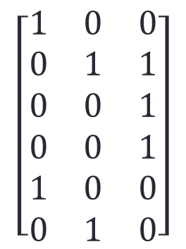

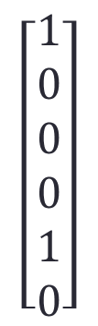
Complicated RNN
$$\left[\begin{matrix}1 \\ \begin{aligned}0 \\ 0\end{aligned}\end{matrix}\right]$$
$$\left[\begin{matrix}1 & 0 & 0 \\ 0 & 1 & 1 \\ 0 & 0 & 1 \\ 0 & 0 & 1 \\ 1 & 0 & 0 \\ 0 & 1 & 0\end{matrix}\right]$$
$$\left[\begin{matrix}1 \\ 0 \\ 0 \\ 0 \\ 1 \\ 0\end{matrix}\right]$$
$$\left[\begin{matrix}0 \\ \begin{aligned}1 \\ 0\end{aligned}\end{matrix}\right]$$
Same
$$\left[\begin{matrix}1 \\ \begin{aligned}0 \\ 0\end{aligned}\end{matrix}\right]$$
*
=
Next Day
$$\left[\begin{matrix}0 \\ \begin{aligned}0 \\ 1\end{aligned}\end{matrix}\right]$$

Slide 25
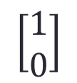
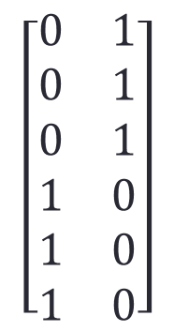


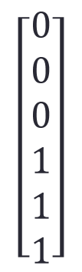
Complicated RNN
$$\left[\begin{aligned}1 \\ 0\end{aligned}\right]$$
$$\left[\begin{matrix}0 & 1 \\ 0 & 1 \\ 0 & 1 \\ 1 & 0 \\ 1 & 0 \\ 1 & 0\end{matrix}\right]$$
$$\left[\begin{matrix}0 \\ 0 \\ 0 \\ 1 \\ 1 \\ 1\end{matrix}\right]$$
$$\left[\begin{aligned}1 \\ 0\end{aligned}\right]$$
=
$$\left[\begin{aligned}0 \\ 1\end{aligned}\right]$$
Weather

Slide 26

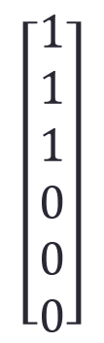
Complicated RNN
$$\left[\begin{aligned}1 \\ 0\end{aligned}\right]$$
$$\left[\begin{matrix}0 & 1 \\ 0 & 1 \\ 0 & 1 \\ 1 & 0 \\ 1 & 0 \\ 1 & 0\end{matrix}\right]$$
$$\left[\begin{matrix}1 \\ 1 \\ 1 \\ 0 \\ 0 \\ 0\end{matrix}\right]$$
$$\left[\begin{aligned}0 \\ 1\end{aligned}\right]$$
=
$$\left[\begin{aligned}0 \\ 1\end{aligned}\right]$$
Weather

Slide 27

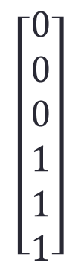
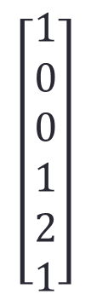
Add
$$\left[\begin{matrix}1 \\ 0 \\ 0 \\ 0 \\ 1 \\ 0\end{matrix}\right]$$
$$\left[\begin{matrix}0 \\ 0 \\ 0 \\ 1 \\ 1 \\ 1\end{matrix}\right]$$
$$\left[\begin{matrix}1 \\ 0 \\ 0 \\ 1 \\ 2 \\ 1\end{matrix}\right]$$
Same
+
=
Next Day
2 means (0 1 0)
Next Day

Slide 28
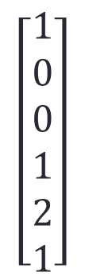
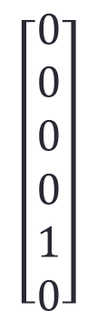
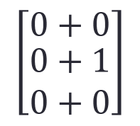
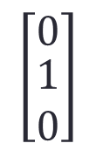
Merge
$$\left[\begin{matrix}1 \\ 0 \\ 0 \\ 1 \\ 2 \\ 1\end{matrix}\right]$$
$$\left[\begin{matrix}0 \\ 0 \\ 0 \\ 0 \\ 1 \\ 0\end{matrix}\right]$$
Non linear
$$\left[\begin{matrix}0+0 \\ \begin{aligned}0+1 \\ 0+0\end{aligned}\end{matrix}\right]$$
$$\left[\begin{matrix}0 \\ \begin{aligned}1 \\ 0\end{aligned}\end{matrix}\right]$$
=
Merge

Slide 29
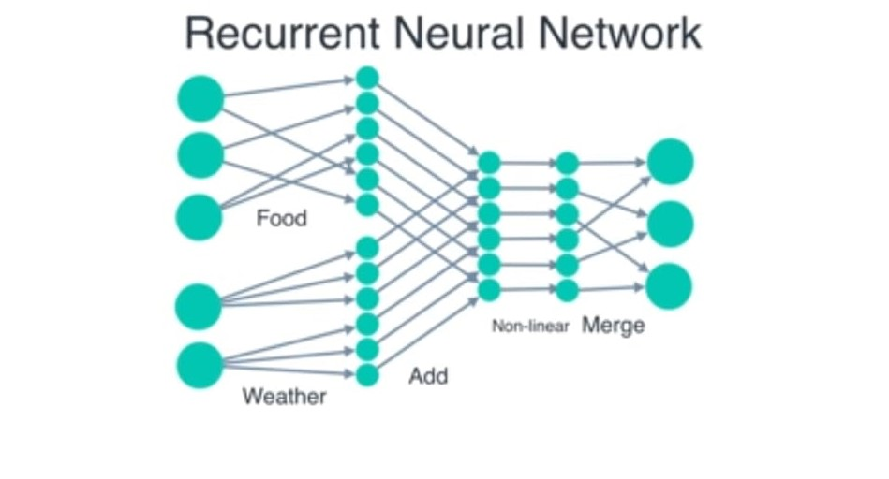

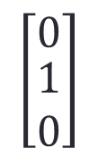

1
$$\left[\begin{matrix}1 \\ \begin{aligned}0 \\ 0\end{aligned}\end{matrix}\right]$$
0
0
$$\left[\begin{matrix}0 \\ \begin{aligned}1 \\ 0\end{aligned}\end{matrix}\right]$$
0
1
0
1
$$\left[\begin{aligned}1 \\ 0\end{aligned}\right]$$
0

Slide 30
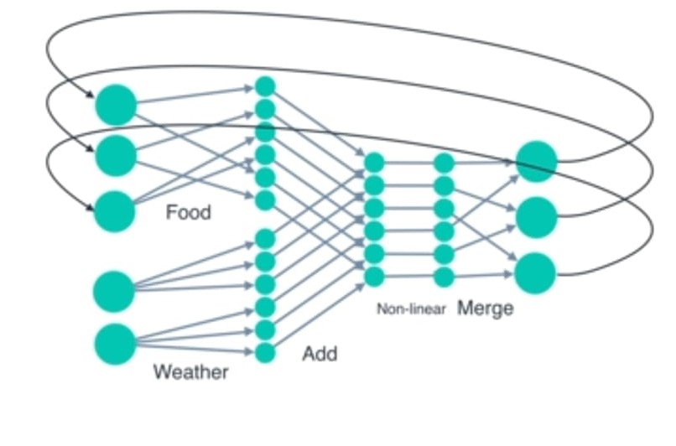

Slide 31
Advantages & Disadvantages
Advantages of Recurrent Neural Network
An RNN remembers each and every information through time. It is useful in time series prediction only because of the feature to remember previous inputs as well. This is called Long Short Term Memory.
Recurrent neural network are even used with convolutional layers to extend the effective pixel neighborhood.
Disadvantages of Recurrent Neural Network
Basic RNN only remember previous input ie short term memory.
Gradient vanishing and exploding problems.
Training an RNN is a very difficult task.
It cannot process very long sequences if using tanh or relu as an activation function.

